Slide 1
UNIFIED TRAVELLING AND TRANSPORT SYSTEM (UTTS)
Explore our ticket bookin system here….

Slide 2

MADHAV INSTITUTE OF TECHNOLOGY & SCIENCE GWALIOR, (M.P) (A Govt aided, UGC autonomous, NAAC accredited institute Affiliated to RGPV Bhopal)
Python Programming (150415)
SKILL BASED MINI PROJECT
TOPIC – UNIFIED TRAVELLING AND TRANSPORT SYSTEM
Presented By:
Abhishek Rajput 0901CS211003
Akhil Jain 0901CS211013
Gauri Thakre 0901CS211046
Harsh shrivastava 0901CS211049
Presented To:
Dr. Devesh Kumar Lal
Department of Computer Science & Engineering

Slide 3
Table of contents
01
02
03
04
05
Introduction
Objectives
Functionality
What is UTTS ?
Study objectives of UTTS here
How the program works
Applications
Conclusions
Applications and future scopes
Synopsis of project

Slide 4
About UTTS
The Unified Travelling and Transport System (UTTS) is a software application that provides a unified platform for booking and managing travelling and transportation services. The system is built using Python programming language and employs a database management system to store and manage information related to travelling and transportation services.

Slide 5
01
Introduction
Introduction to UTTS

Slide 6
What is UTTS?
The Unified Travelling and Transport System (UTTS) is a comprehensive platform that allows users to search, book, and manage various transportation services such as public transport, ride-sharing, and logistics, among others.
The UTTS leverages a database management system to store and retrieve data related to transportation services, including routes, schedules, pricing, and availability.
UTTS offers a reliable and efficient platform for booking and managing transportation services, making travel planning easy and convenient for users.

Slide 7
02 Objectives

Slide 8
Study objectives
Providing a Unified Platform
Efficient data management
To access information related to different transportation services
Advanced security measures
To ensure efficient data storage and retrieval, making it capable of handling a large number of users and transactions
To ensure that user information is kept safe and secure

Slide 9
03 FUNCTIONALITY

Slide 10
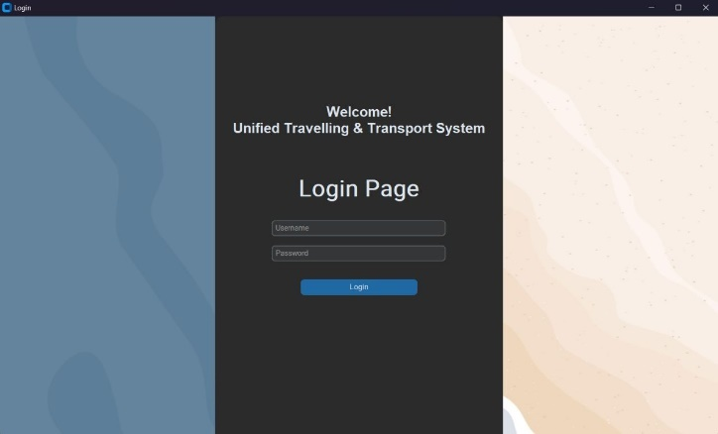
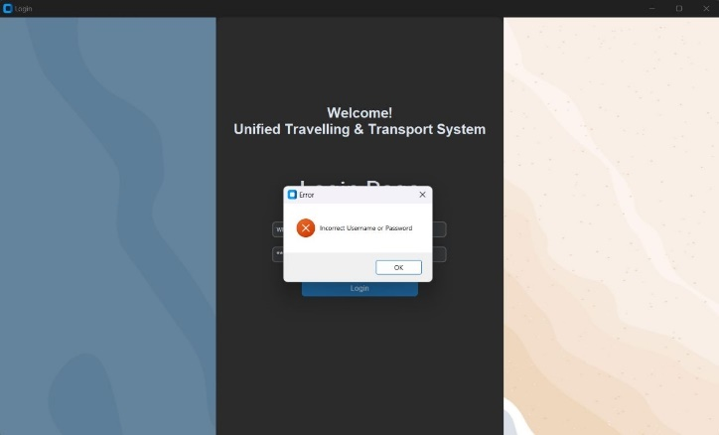
Login Page

Slide 11
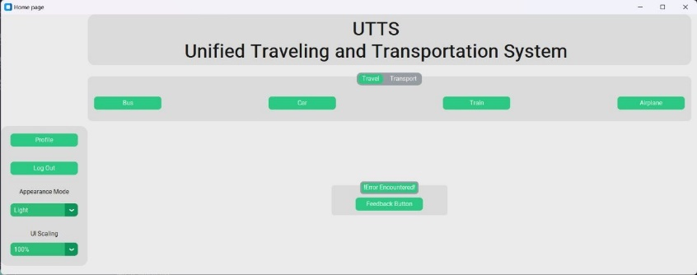
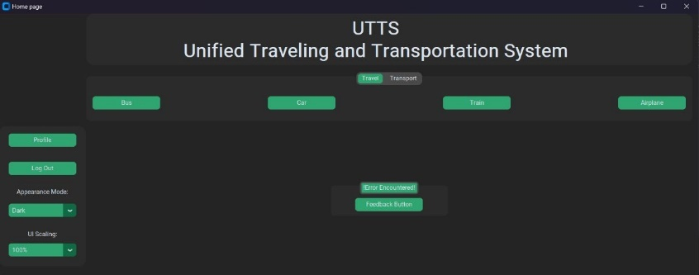
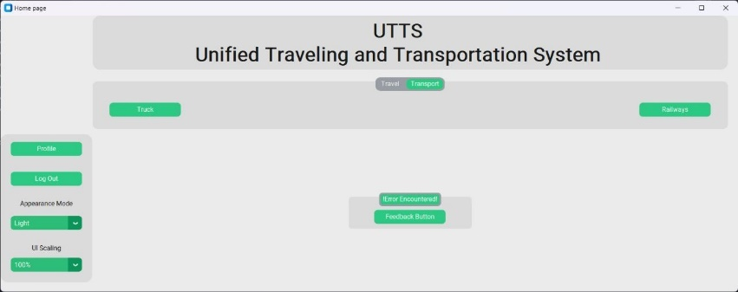
Home Page

Slide 12
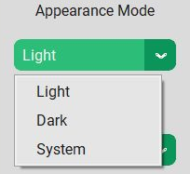
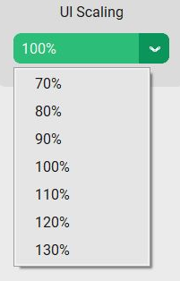
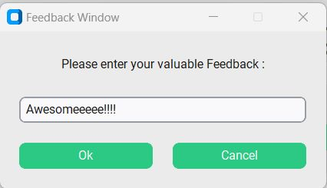
Home Page Features
User 03
Admin 02

Slide 13
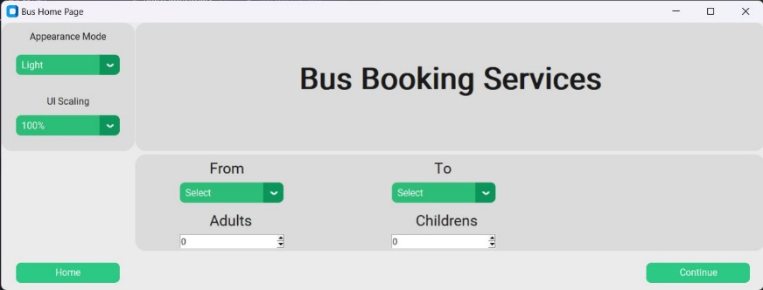
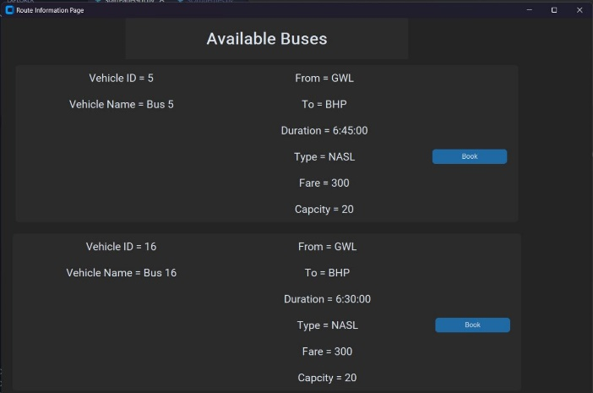
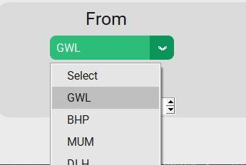
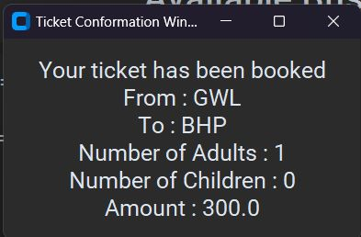
Bookings
User 03

Slide 14

Logout Button

Slide 15
04 Applications & Future Scopes
Various applications and future scopes of UTTS project

Slide 16
Applications of UTTS include :-
Application 01
Application 02
Application 03
Public transportation
Air travel
Ride sharing services
Application 04
Application 05
Application 06
Travel agencies
Logistics services
Delivery services

Slide 17
Future Scope
01
02
03
04
Integrating with emerging technologies
Expansion to new market
Collaboration with transport providers
Integrating with smart city initiatives
Integrating with AI, Blockchain, IOT
can be further extended to whole travel booking system
To provide user with a better travelling experience
For optimizing transportation routes and schedules

Slide 18
Jupiter's rotation period
05
Conclusion
The Sun’s mass compared to Earth’s
Conclusion of project

Slide 19
Conclusion
The Unified Travelling and Transport System (UTTS) is a promising platform for booking and managing transportation services, providing a unified and efficient experience for users.
The system enables users to search for and book transportation services based on their travel requirements, providing real-time information on availability, schedules, and pricing.
The UTTS incorporates advanced security measures to protect user data and employs a database management system for efficient data storage and retrieval.

Slide 20
Thanks!

